Slide 1

Global Superstore Capstone Project
Ossai Isioma | Data Analytics | 8A

Slide 2
Table of contents
01
02
03
04
05
06
Objectives
Resources & Project Recap
Problem
Process
Insight
Summary

Slide 3
Objectives
Our aim
To analyze and draw out meaningful insight from the Global Superstore Dataset which would aid management in making informed decisions to improve performance and profitability.
KPI Requirements
Total Sales
Total Profit
Total Quantity
Total Average Delivery Days

Slide 4
Chart Requirements
Sales by Segment
Top 10 Customers
Top 3 Countries with Highest Profit
Top 5 Loss Product
Sales by Market
Bottom 3 Countries with Lowest Profit
Top 5 Products
Sales by Region

Slide 5
Resources
Human
resources
Physical resources
The Data Analyst is responsible for the successful execution of the project.
Our project requires a number of specialized pieces of equipment. We will be using
[Microsoft Excel: Data Cleaning, Pivot Table;
Microsft PowerBI: PowerQuery, Data Modelling, Data Visualization]

Slide 6
Project Recap
The "Global Superstore" dataset offers information on order entries made from 2011 to 2014.
The dataset includes data on: Order ID, Order Date, Ship Date, Customer Name, Segment, City, State, Country, Market, Region, Product ID, Category, Subcategory, Product Name, Sales, Quantity, Discount, Profit, Shipping Cost, Order Priority.

Slide 7
Problem
1
2
3
What are the three countries that generated the highest total profit for Global Superstore in 2014?
For each of these three countries, find the three products with the highest total profit. Specifically, what are the products’ names and the total profit for each product?
Identify the 3 subcategories with the highest average shipping cost in the United States
Assess Nigeria’s profitability (i.e., total profit) for 2014. How does it compare to other African countries?
What factors might be responsible for Nigeria’s poor performance? You might want to investigate shipping costs and the average discount as potential root causes.
4
Identify the product subcategory that is the least profitable in Southeast Asia. Note: For this question, assume that Southeast Asia comprises Cambodia, Indonesia, Malaysia, Myanmar (Burma), the Philippines, Singapore, Thailand, and Vietnam.
Is there a specific country in Southeast Asia where Global Superstore should stop offering the subcategory identified in 4a?
5
Which city is the least profitable (in terms of average profit) in the United States? For this analysis, discard the cities with less than 10 Orders.
Why is this city’s average profit so low
6
a. Which product subcategory has the highest average profit in Australia?
7
Which customer returned items and what segment do they belong b) Who are the most valuable customers and what do they purchase?

Slide 8
Process
Data Understanding
Data Cleaning
Data Analysis
Data Visualization
Uncover Insights
Recommendations

Slide 9
$12.6M
4
Canon imageCLASS 2200 Advanced Copier
Insights
$1.47M
Total Sales
Total Profit
United States
Average Delivery Days
Most Profitable Country
Tom Ashbrook
Best Product
Top Customer

Slide 10
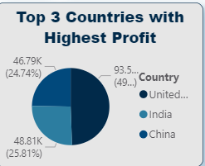
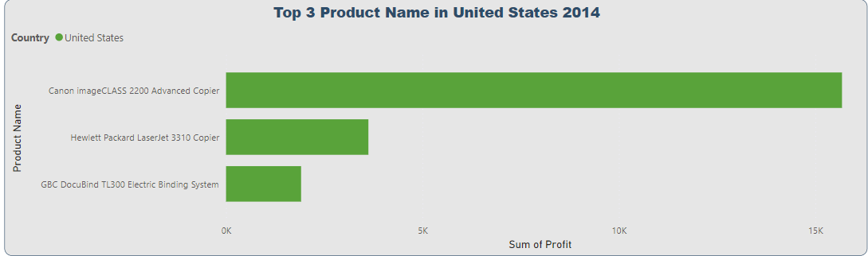
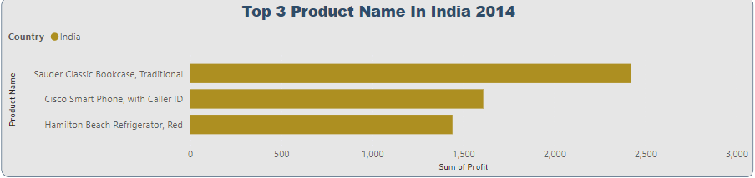
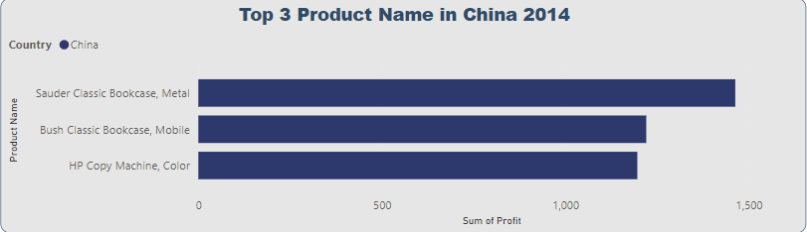
1a. The countries with the highest total profit in 2014 are:
United States
India
China
1b. The top 3 products for each country in 2014
United States [Canon imageCLASS 2200 Advanced Copier; Hewlett Packard LaserJet 3310 Copier; GBC DocuBlind TL300 Electric Binding System]
India [Sauder Classic Bookcase, Traditional; Cisco Smart Phone, with Caller ID; Hamilton Beach Refrigerator, Red]
China [Sauder Classic Bookcase, Metal; Bush Classic Bookcase, Mobile; HP Copy Machine, Color]

Slide 11
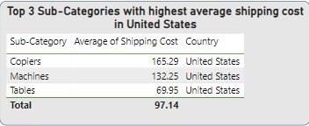
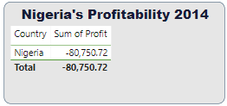
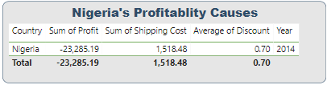
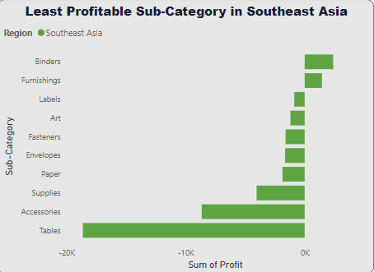
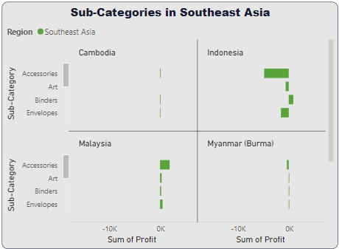
The top 3 Sub-Categories with the highest average shipping cost in the United States are: Copiers, Machines and Tables
Nigeria’s profitability as seen sums up to -$80,750.72 . The Cause for this is as a result of high cost of shipping and little to no discount (2014).
The Least Profitable Sub-Categories in Southeast Asia is: Binders
The Country in Southeast Asia where the Global superstore should stop offering This Sub-Category is Cambodia

Slide 12
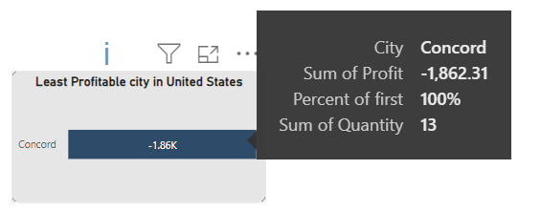
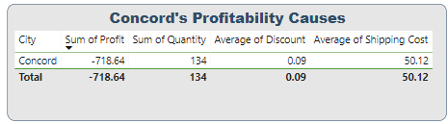
Concord is the least profitable city in the United States
This is due to relatively high shipping cost and little to no discount

Slide 13
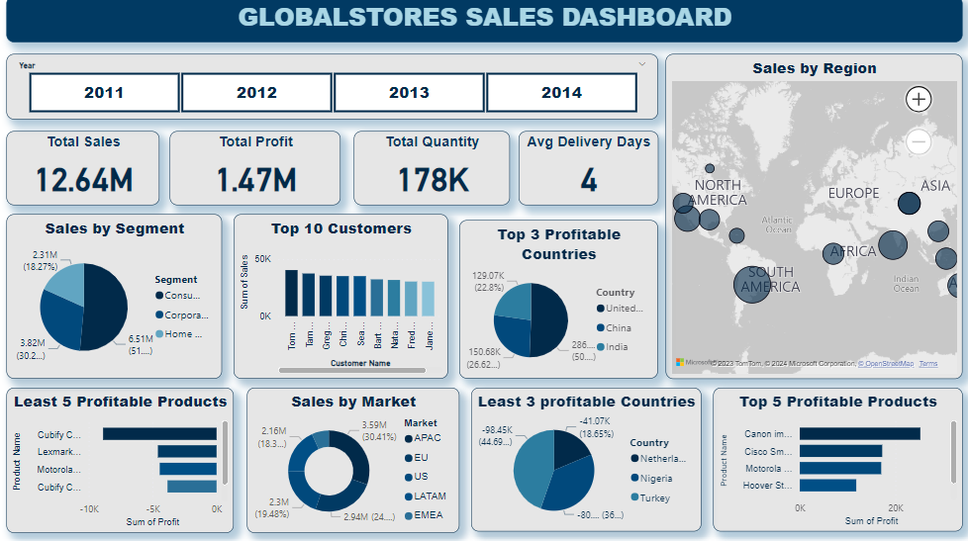

Slide 14



Recommendation & Conclusion
A Customer Loyalty Program can be introduced, this will encourage more customers on the Global Superstore
Focus more on Top Regions, Invest more resources in marketing and advertising efforts in these areas to further boost sales
Offer Attractive discounts: Introduce regular sales and promotion to incentivize customers to make purchases. Consider offering discounts on popular products or bundling items together for a discounted price. This can help improve sales in regions/countries with low profit.
Streamline Shipping Costs: Evaluate Shipping Cost and find a way to optimize them. This could include negotiating better rates with shipping partners or implementing efficient logistics strategies to reduce costs.
Enhance online shopping experience: Invest in user-friendly website and mobile app, ensuring smooth navigation, easy checkout, and secure payment options. This will encourage customers to shop online and increase sales.

Slide 15
Thank you!

